Slide 1

Discover India:
Exploring Indian Monuments
PG-DAC
Project Group No. G-18
Divya Kumar Bhargav (230341220061)
Ojas Umredkar (230341220110)
Supervisor : Mrs. Megha Mane

Slide 2

Exploring Indian Monuments
Welcome to the Indian Monuments app - your one-stop-shop for all things historical in India. Discover centuries of culture, architecture, and religion with just the swipe of your thumb.

Slide 3

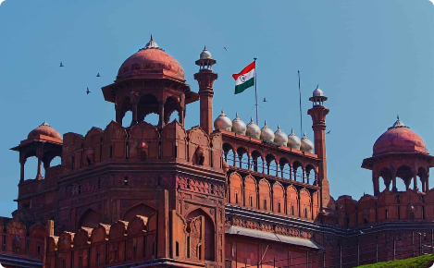
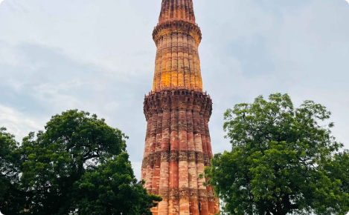
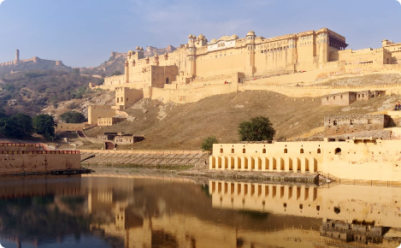
Key Features
Comprehensive Information
Online Ticket Booking
Learn about each monument's unique historical background, architectural style, and cultural significance with our comprehensive and detailed database.
Skip the queue and book your tickets online directly through the Indian Monuments app, making your visit smoother and more efficient.
User Reviews & Ratings
Admin Interface for Management
Rate and review each monument based on your experience to share your thoughts and help others plan their itineraries.
As an admin, manage ticket bookings, monitor user reviews, and add new monuments to the database, ensuring the highest levels of quality and satisfaction for our users.

Slide 4
Benefits of Using Indian Monuments App
Time-Saving
Cost-Effective
Cultural Immersion
Plan your visit efficiently by accessing detailed information and ticket booking services in one place.
Save money on travel agent fees and learn how to navigate each monument independently, avoiding unnecessary expenses and maximizing your cultural experience.
Experience India's rich history and diversity first-hand with our detailed information and immersive multimedia content.

Slide 5
Benefits of Using Indian Monuments App
Our app makes it easy for users to access the latest monument information, ticket bookings, and much more at their fingertips.
We have detailed information and high-quality photographs of each monument, giving users a comprehensive understanding of its cultural significance
Easy access
Rich content
Interactive
Our app offers an interactive experience with virtual tours, augmented reality features, and an online community to share experiences and tips.

Slide 6
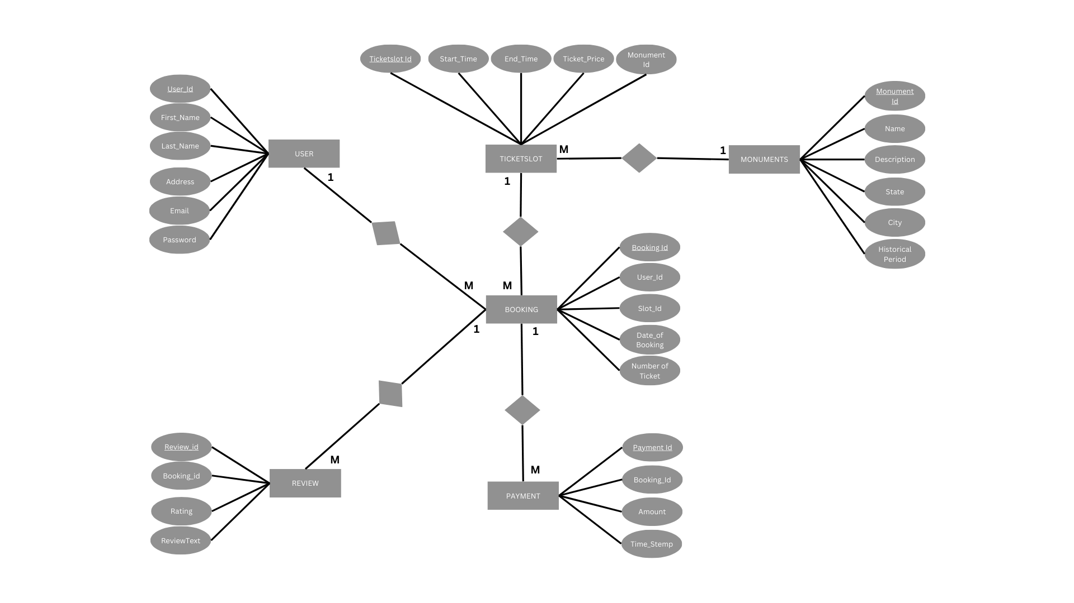
ER Diagram

Slide 7
User Login and Registration
Easy Login
Registration
Users can easily login with their social media accounts or create a new account with their email and password in just a few clicks.
Our registration form is simple and easy to understand, ensuring that even novice app users can quickly create a new account.

Slide 8
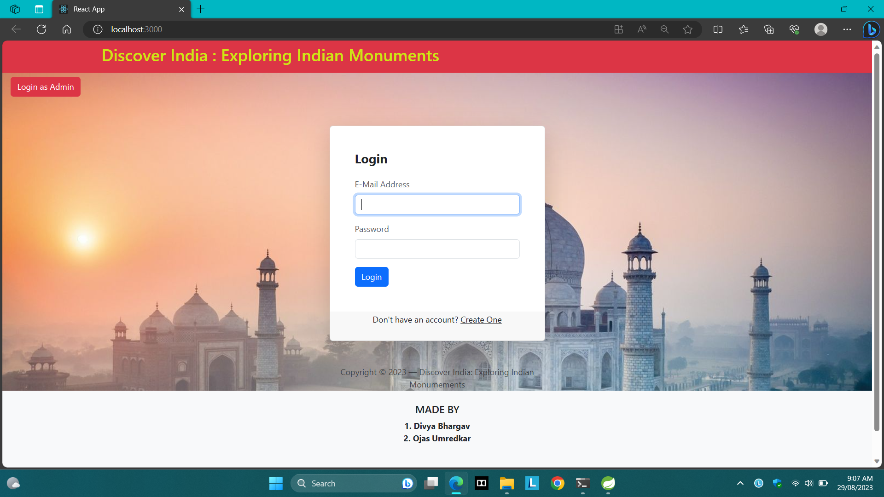

Slide 9
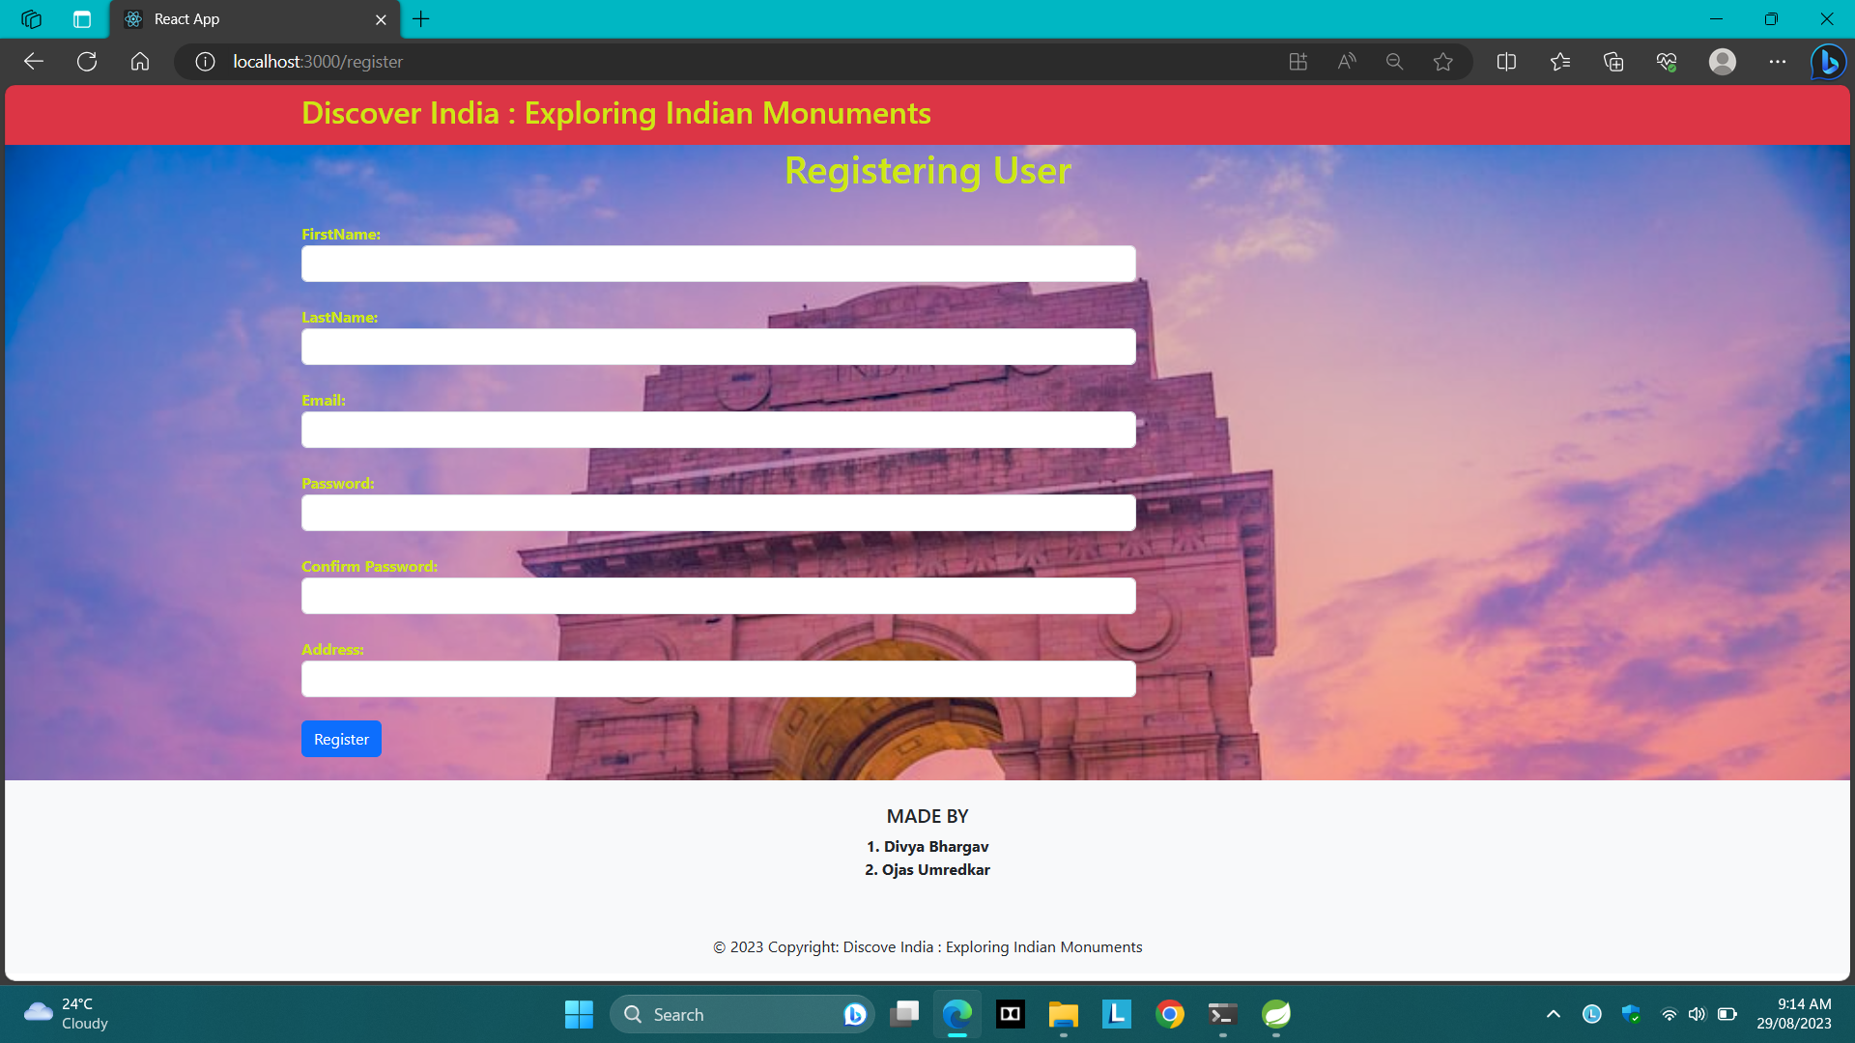

Slide 10
Accessing Monument Information and Booking Tickets
Booking and Payment
Users can easily book tickets with a few clicks and pay securely with multiple payment options, making the booking process smooth and hassle-free.
1
2
3
Search and Filter
rating and Review
Our app has an easy-to-use search and filter feature to help users find the precise monument they want to visit and access detailed information about it.
Users receive vouchers and QR codes in their email or in-app profiles that they can easily present at the monument for admission, avoiding long lines.

Slide 11
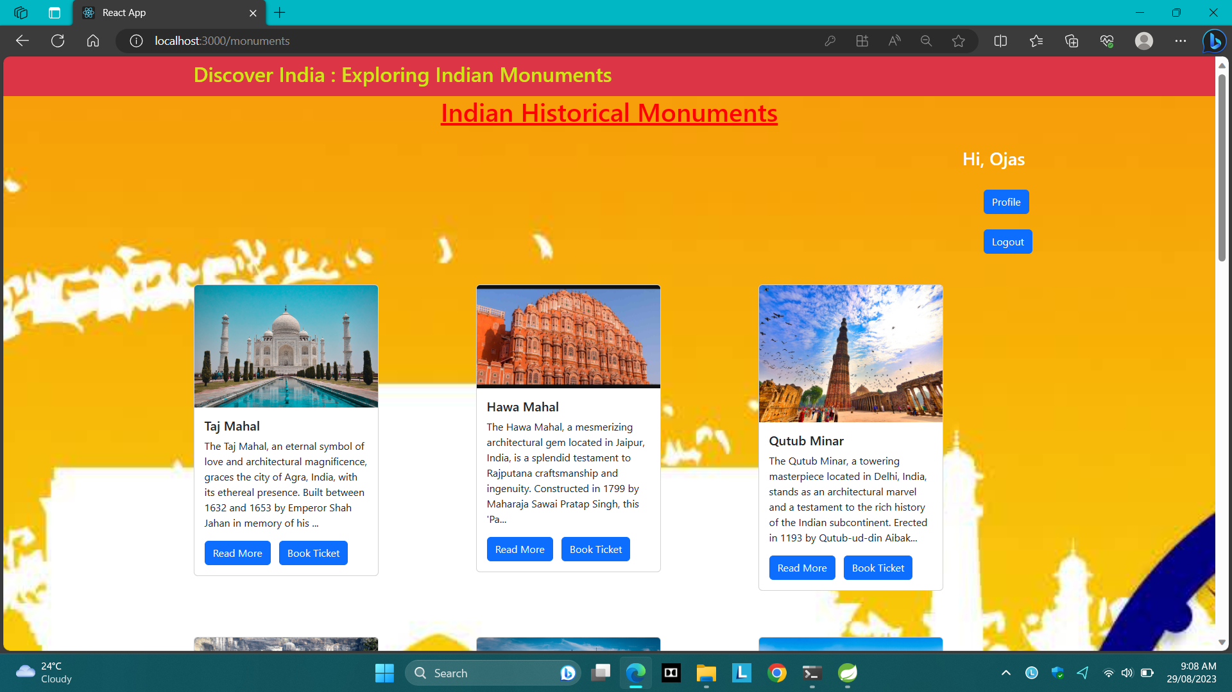

Slide 12
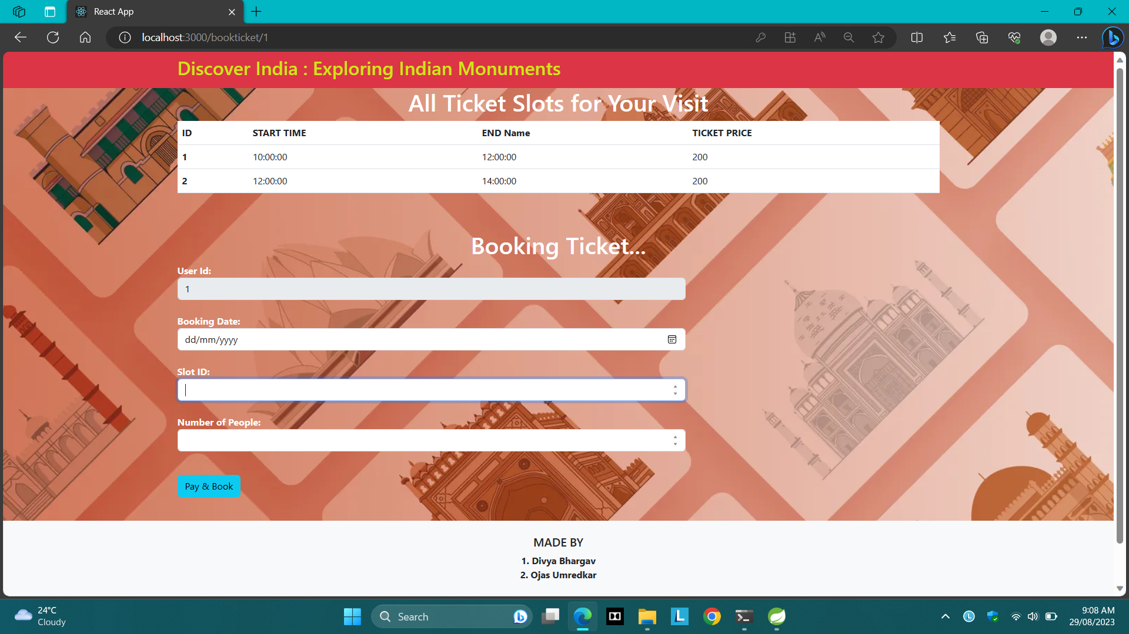

Slide 13
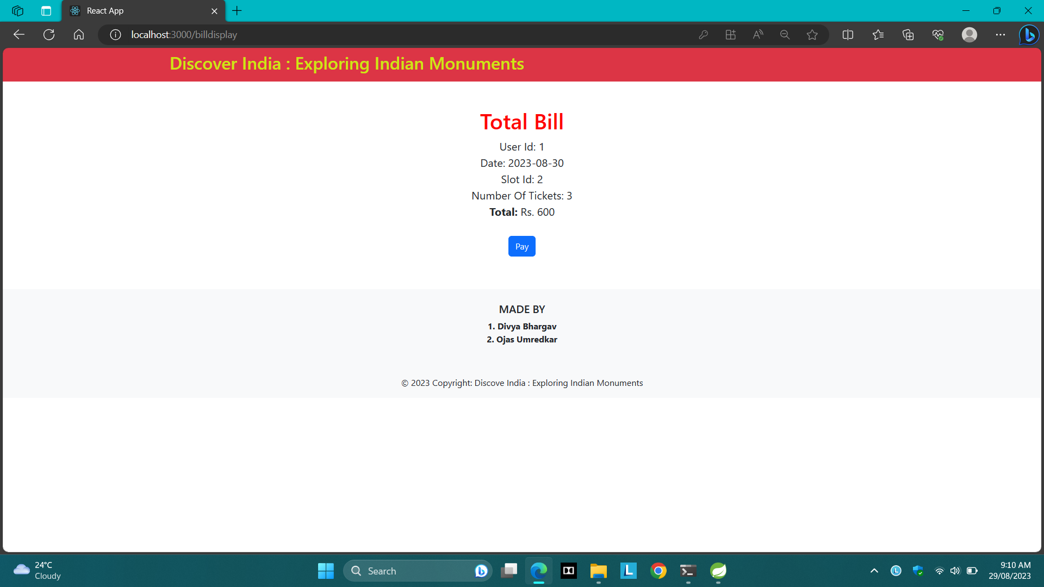

Slide 14
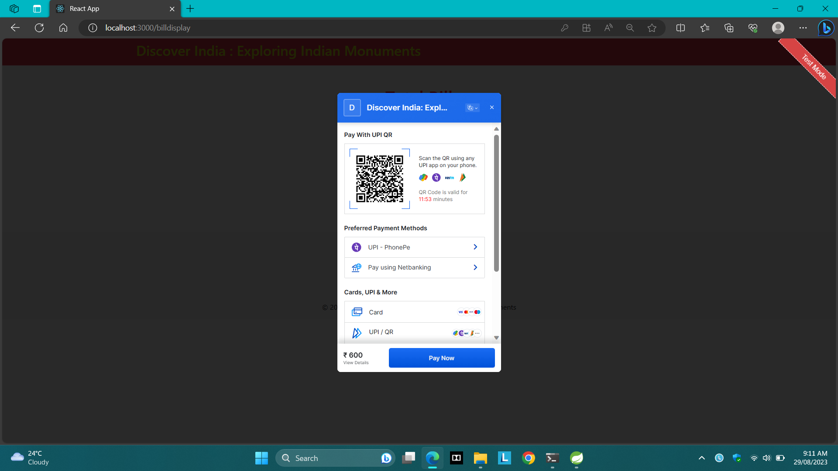

Slide 15
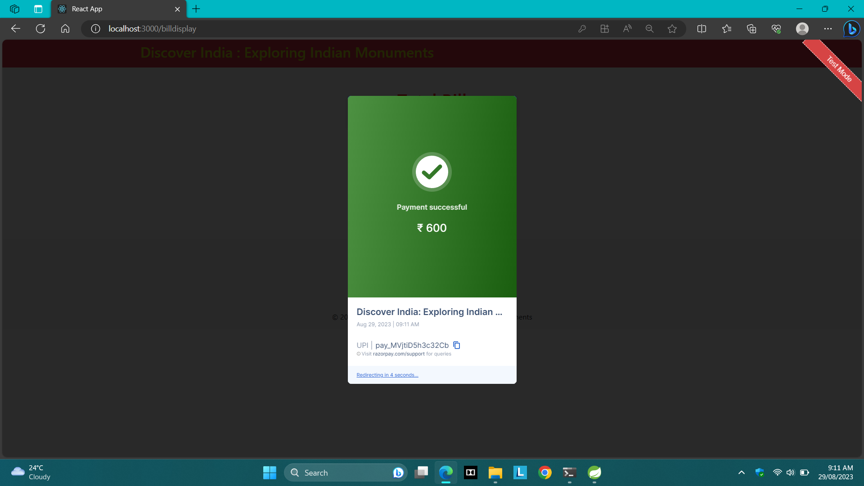

Slide 16
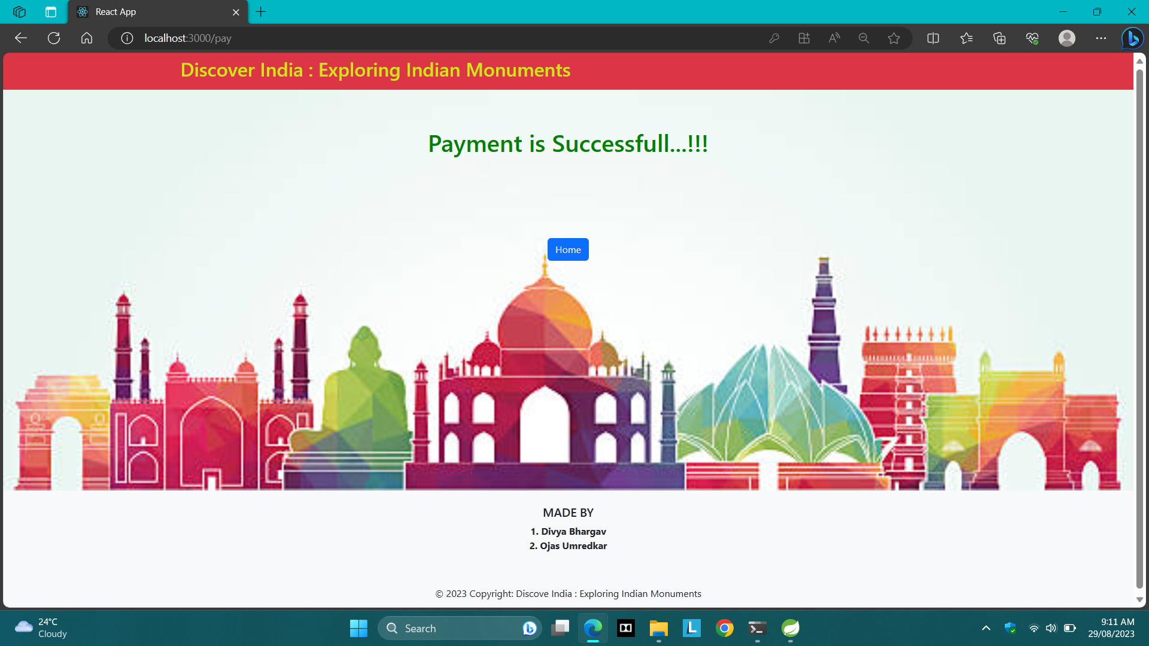

Slide 17
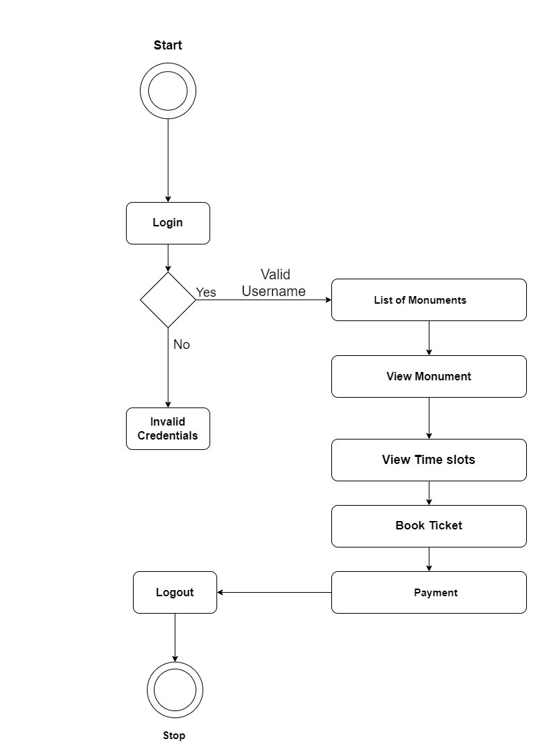

Slide 18
Admin Login and Managing Monument Details
Efficient management
Secure access
Admins can easily manage monument details, such as name, location, admission fees, and timings, through our app's intuitive interface.
Admins can securely login in the app and access the monument management dashboard, which has appropriate access controls to ensure data privacy.

Slide 19
Admin Managing Bookings and User Interactions
Booking Dashboard
Interactions
Advanced Analytics
Admins can track all booking information through our app's booking dashboard and can even generate reports or respond to user inquiries directly.
Admins can have live interactions with users through our in-app review feature and get feedback.
Admins can use our app's advanced analytics features to monitor user behavior and bookings, and use the insights to improve business outcomes.

Slide 20
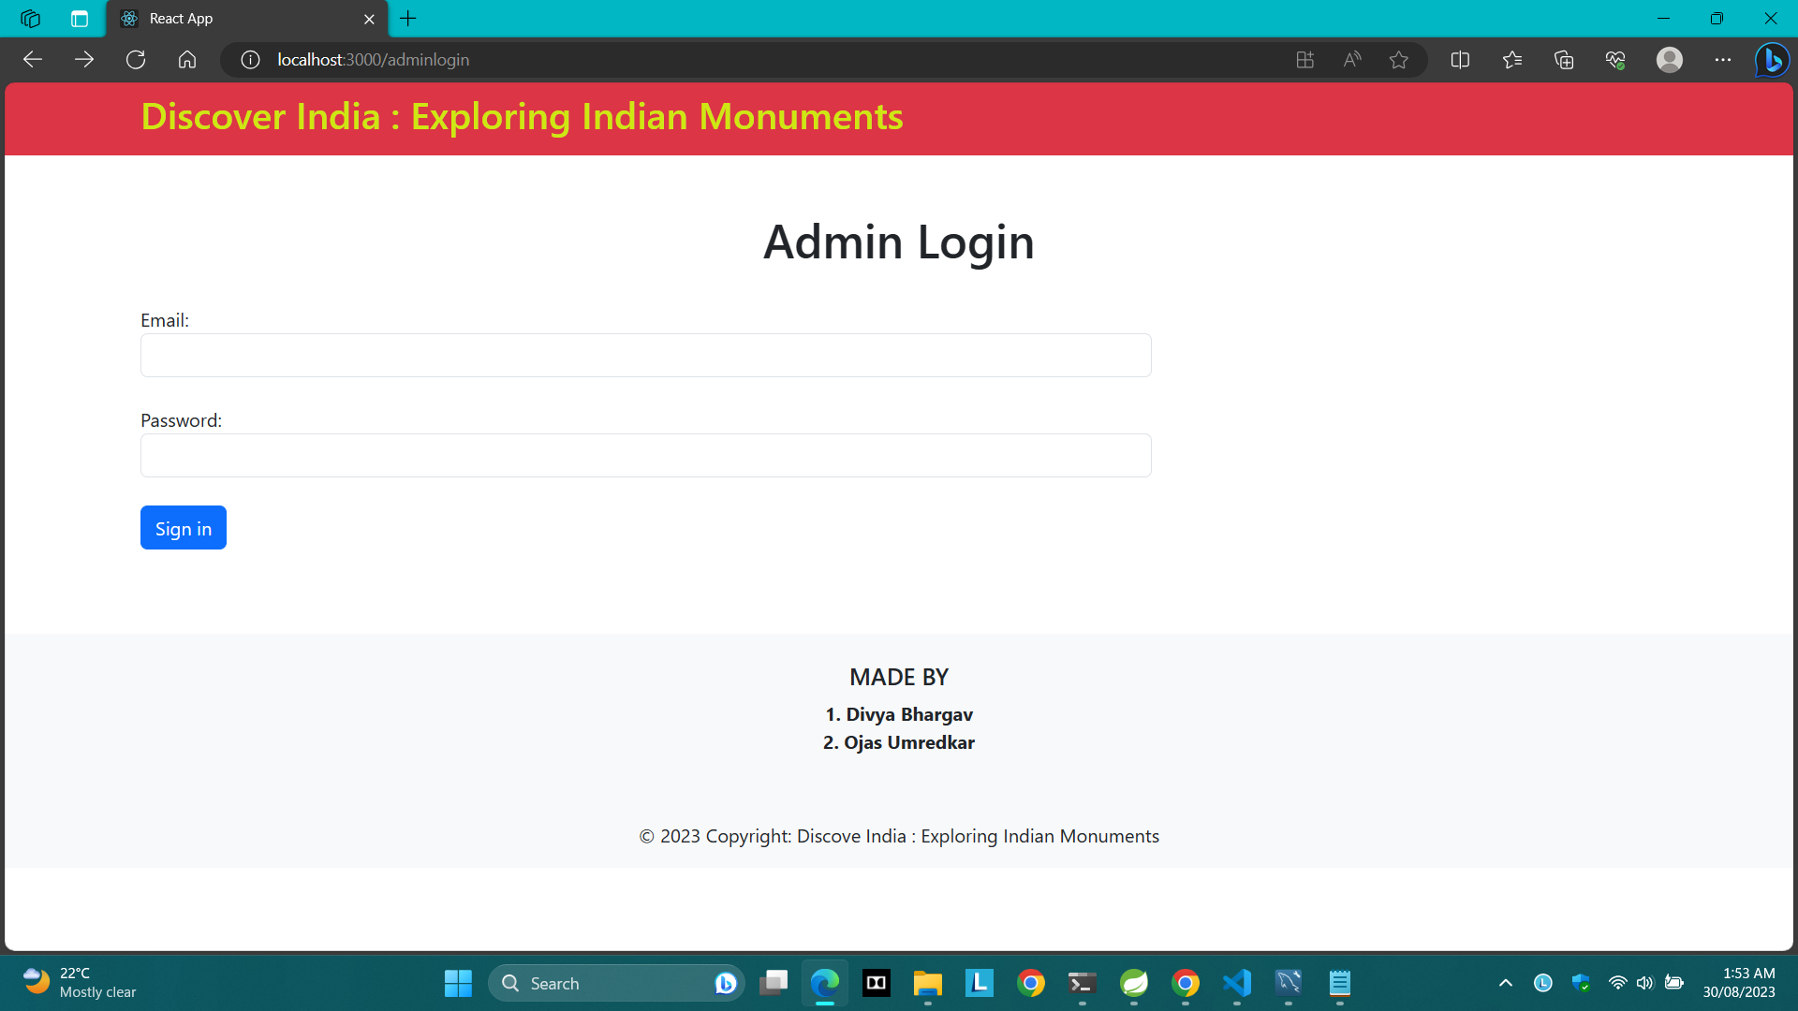

Slide 21
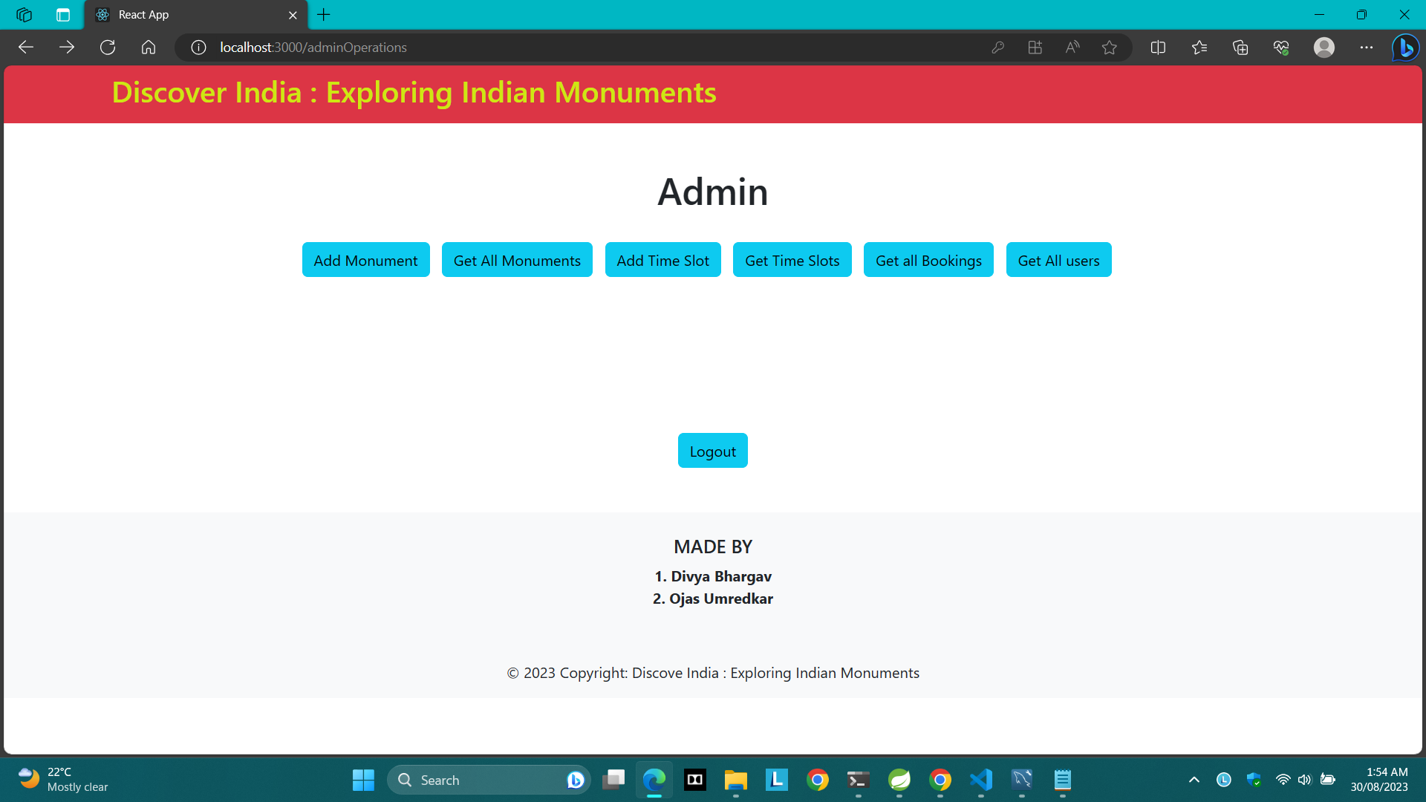

Slide 22
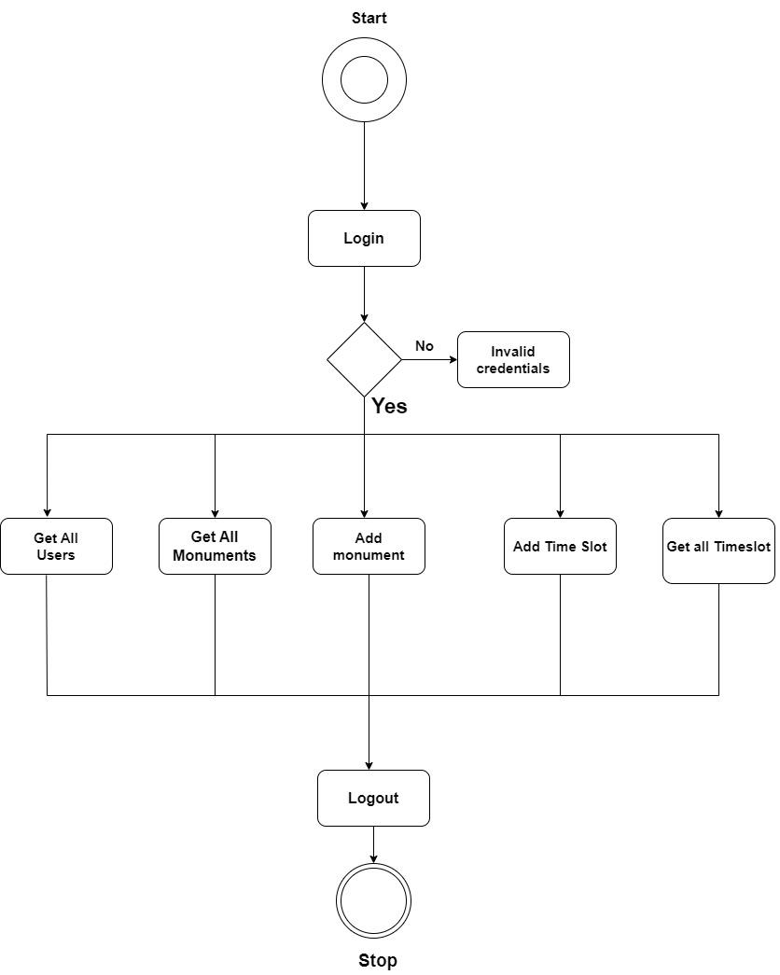

Slide 23
Future Plans & Enhancements
1
Expanded Monuments Database
Continuously add new monuments and locations to widen our scope and enhance our users' experience, with a particular focus on lesser-known destinations.
Guided Audio Tours
2
Coming soon to the Indian Monuments app - in-app audio tours of each monument, offering in-depth information and insights into each location's history and cultural contexts.
3
Multi-Language Support
We plan to introduce multi-language support for the Indian Monuments app, offering comprehensive information in Hindi and other regional languages to make the app accessible and user-friendly for all.

Slide 24

Conclusion & Call to Action
The Indian Monuments app is the perfect tool for anyone interested in exploring India's rich historical legacy. From comprehensive information to ticket bookings and user reviews, we offer everything you need to make the most of your visit. Download the Indian Monuments app now and start your cultural journey today!

